Slide 1
HTML for beginners part 1

Slide 2
Introduction
Hello!
Notes:
I’m Sandy-Lee Edwards
Senior Software Engineer with 15 years experience
Things I like

Slide 3
CVs, UI, HTML, CSS
What are we going to be doing this year? A recap.
Notes:
Previous session we designed our CV
The rest of the year we will be focusing on coding basics to create your own web CV, these coding languages will include HTML, CSS and JavaScript.

Slide 4
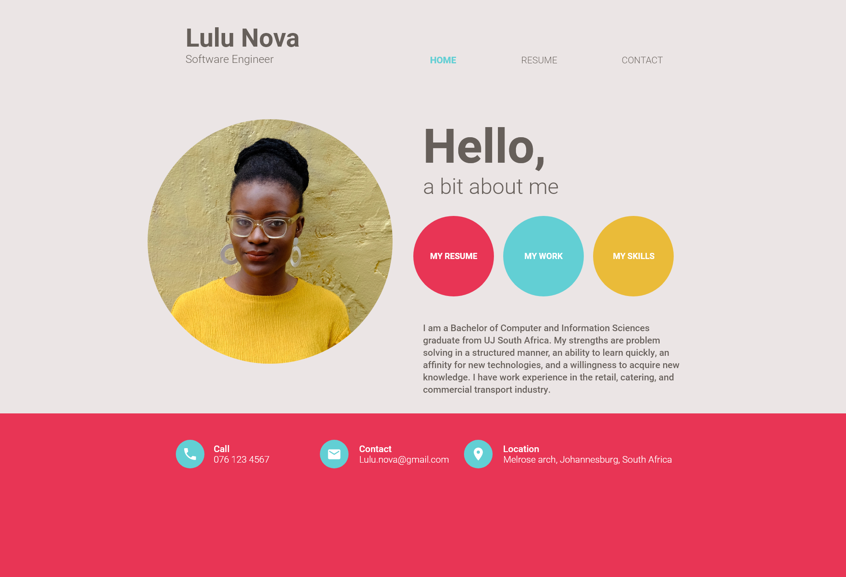
Our CV design
Notes:
Remember the beautiful CV we designed last month?

Slide 5
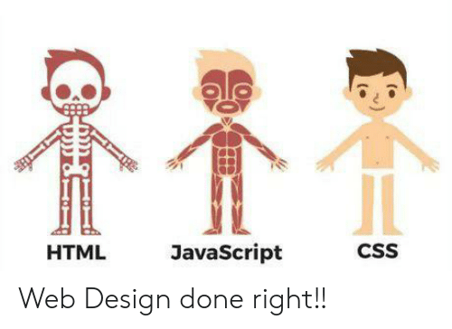
Lets start with the bones first!
Notes:
Well now lets get started on how to build it… starting with the bones!

Slide 6
Today
What is HTML?
Basic building blocks of HTML
Building our first HTML document
What’s gone wrong?
Breaking down our CV design
Useful links
Notes:
But for today

Slide 7
1. What is HTML?
Is it something you can eat?

Slide 8
HTML basics
HyperText Markup Language
Markup language converted into websites by the browser
NOT a programming language
Notes:
Not a programming language as it is not dynamic, but organises and formats documents like word

Slide 9
Get your history fix:
First published in 1991, by Tim Berners-Lee from Switzerland.
Consisted of only 18 tags(there are currently around 140)
Managed by the World Wide Web Consortium (or WWWC or W3C). These guys develop standards and protocols to which HTML (amongst other languages) must conform. (You too, Internet Explorer!!)

Slide 10

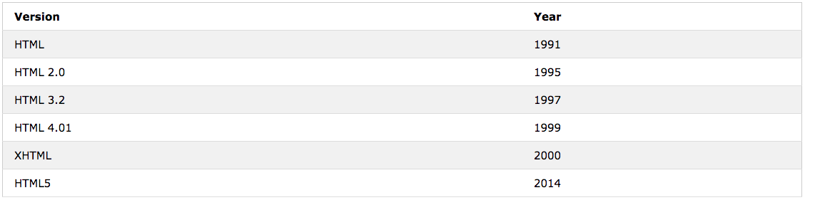
Things to note
HTML’s file extension (.html) tells the browser what to render
Current version is HTML 5 – biggest and best upgrade so far!
New versions are few and far between
Notes:
HTML5 is a lot more forgiving in its syntax than XHTML: you can write tags in uppercase, lowercase or a mixture of the two.

Slide 11
HTML family
HTML tells browser what and how to display
Some other members of the family are:
CSS(Cascading style sheets)
Javascript
jQuery
React
Angular
Notes:
CSS -> how to display
Javascript -> dynamic
React -> library to build UI components
Angular -> structural framework

Slide 12
2. Lets get into this
The basic building blocks of HTML

Slide 13


Before we even think about code…
We need somewhere to do our actual code
Many options available:
Sublime
Notepad++ (windows only)
Notepad
Various other IDE’s
We’ll be using Sublime
Notes:
IDE = integrated development environment

Slide 14
And now… the “Great Debate”
Tabs
vs
Spaces

Slide 15
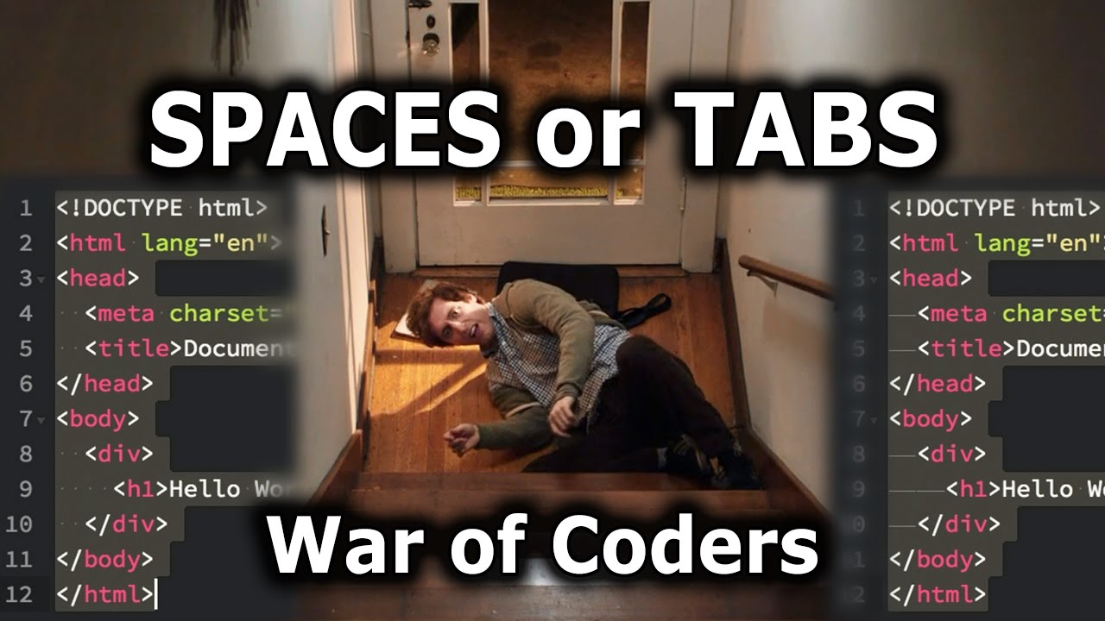

Slide 16
Activity time
Setting up our sublime

Slide 17
Lets get started with our cv
Open your chosen editor(Sublime or Notepad++)
Create a new document and save it as “home.html”

Slide 18
What makes an HTML document?
Elements
Elements are what make up HTML
Elements are represented by tags
Examples:
Pictures
Headings
Text
Tags
Programmatic way to represent elements
Rendered into the web page

Slide 19
More about tags
Tags begin and end with angled brackets <>
You need to tell the browser your tag is complete with a forward slash /
Most tags have an open and close:
<p>…example text…</p>
Some tags don’t have a close tag, but need to still be closed:
<br/>

Slide 20


Now its time for a little dinner…

Slide 21
Nesting tags
Tags can be containers to further content
You need to open your container, and ensure that you close it again.
Using formatting will help to ensure you are forming your HTML correctly
<tag>
<nested_tag>
</nested_tag>
</tag>
<tag>
<nested_tag>
</tag>
</nested_tag>

Slide 22
Nesting tags contd…
<p>
This is the beginning of my paragraph
<b>
This is my bold text in my paragraph
</b>
This is after my bold text
</p>
<p>
This is the beginning of my paragraph
<b>
This is my bold text in my paragraph
</p>
</b>
This is after my bold text

Slide 23
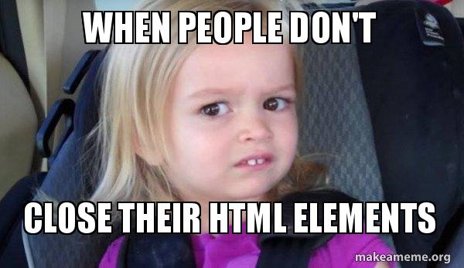
Some humour to get us through…

Slide 24
3.Building our first HTML document
Ok, let me at it!

Slide 25
A basic HTML document layout
<!DOCTYPE html>
<html>
<head>
<title>Page Title</title>
</head>
<body>
<h1>My First Heading</h1>
<p>My first paragraph.</p>
</body>
</html>

Slide 26
Doctype
<!DOCTYPE html>
<html>
<head>
<title>Page Title</title>
</head>
<body>
<h1>My First Heading</h1>
<p>My first paragraph.</p>
</body>
</html>

Slide 27
Doctype
Tells the browser more about the type of document
Many iterations in the past
XHTML 1.0 Strict?
HTML 4.01 Transitional?
HTML 4.01 Strict?
HTML 5?
Note that this one is not closed because it is not an element.
Not strictly required, but you should include it.

Slide 28
HTML root element
<!DOCTYPE html>
<html>
<head>
<title>Page Title</title>
</head>
<body>
<h1>My First Heading</h1>
<p>My first paragraph.</p>
</body>
</html>

Slide 29
HTML root element
Root element
It is the base of the entire document and thus the parent of all elements
First element to open and last to close in the document

Slide 30
Activity time
Starting our html page

Slide 31
Lets get started with our cv contd…
Add the doctype:
<!DOCTYPE html>
Create the root element:
<html> </html>

Slide 32
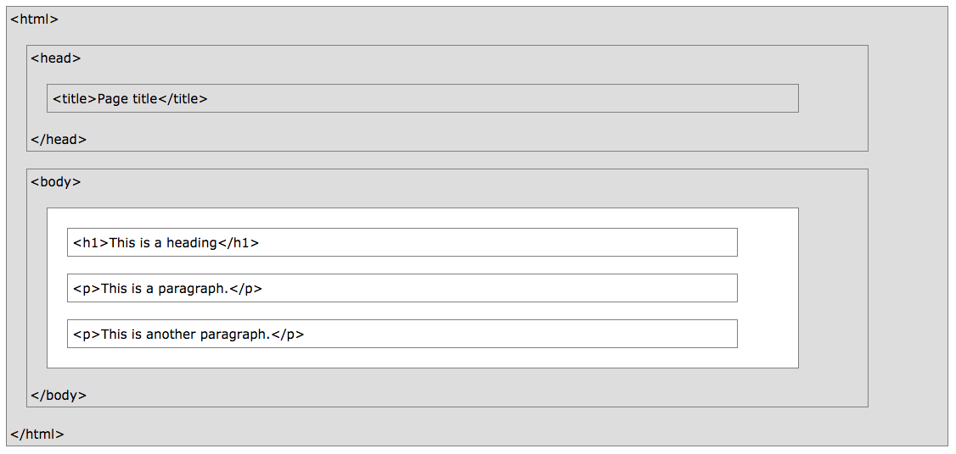
And now for the meaty bit
Root HTML element
Head Section
Body Section

Slide 33
The head element
<!DOCTYPE html>
<html>
<head>
<title>Page Title</title>
</head>
<body>
<h1>My First Heading</h1>
<p>My first paragraph.</p>
</body>
</html>

Slide 34

Head element
Visible elements:
<title> - It is this ->
Invisible elements:
<style> - To add CSS
<link> - Link to another file
<script> - To add JavaScript and jQuery
<meta> - To add more information about the document

Slide 35
More about Meta tags
Defines the metadata(information) of an HTML page
Examples:
Description
Keywords
Author
Viewport
Used for SEO mainly
Viewport was introduced with HTML5 for responsive design
<meta name="viewport" content="width=device-width, initial-scale=1.0">

Slide 36

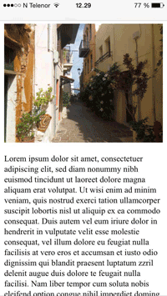
Viewport effect
Without viewport
With viewport

Slide 37
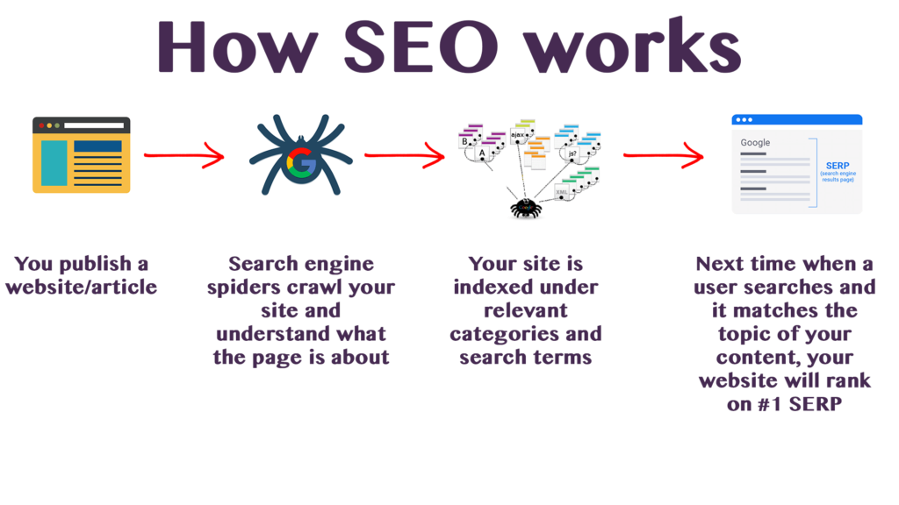
What is SEO?
SEO = Search engine optimization
It is the practice of increasing the quantity and quality of traffic to your website through organic search engine results

Slide 38
Activity time
Lets set up our head tag

Slide 39
Lets get started with our cv contd…
Add the header element:
<head>
<title>Page Title</title>
</head>

Slide 40
The body
<!DOCTYPE html>
<html>
<head>
<title>Page Title</title>
</head>
<body>
<h1>My First Heading</h1>
<p>My first paragraph.</p>
</body>
</html>

Slide 41
Body element
This is where the content is placed in tags
Various tags are available to use for display of content
Common text formatting elements: <h1>Header 1</h1> <h2>Header 2</h2> <h3>Header 3</h3> <h4>Header 4</h4> <h5>Header 5</h5> <h6>Header 6</h6> <p> Paragraph </p> | More common text formatting elements: <i>italics</i> <s>strikethrough</s> <b>bold</b>or<strong>bold</strong> <u>underlined text</u> <sup>superscript ^{look!} </sup> <sub>subscript _{look!}</sub>

Slide 42
Activity time
Lets add our body now

Slide 43
Lets get started with our cv contd…
Add the body element:
<body>
<h1>My First Heading</h1>
</body>

Slide 44
Lets get started with our cv contd…
Save the document
Double click to open it in your browser
What do you see?

Slide 45
Recap
We need a doctype declaration
We need the root HTML element
We need a head section
We need a body section
We can put things in the body section
Always remember to open and close in order

Slide 46
4. What’s gone wrong?
How do we see what’s going on?

Slide 47
Developer tools
Most browsers come with some form of “Dev tools”
Press F12 to find it (or navigate to it)
Shows the code behind and allows you to test changes live
Let’s have a look…

Slide 48
5. Back to our CV
Where do we even begin to create our CV?

Slide 49
Our CV design

Slide 50
Break it down
Branding
Header area
Menu
2 column container
Body section
Footer area
Centered 3 column container

Slide 51
6. Useful links
Help! I need more!

Slide 52
Useful links
HTML cheat sheet: https://htmlcheatsheet.com/
Sublime download: https://www.sublimetext.com/3
W3Schools tutorials: https://www.w3schools.com/html/default.asp
Games that teach you HTML:
Here’s a list of 10
CodePip (super cool)

Slide 53
Thanks!
ANY QUESTIONS?
You can find me at:
sandy-lee.edwards@entelect.co.za

